Slide 1
Game Audio via OpenAL
Rich Davison

Slide 2
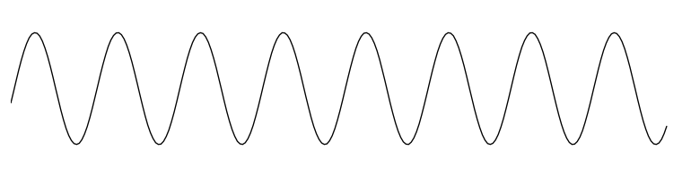
Sound Waves
Amplitude
(Larger == Louder)
Frequency
(Shorter == Higher pitch)

Slide 3
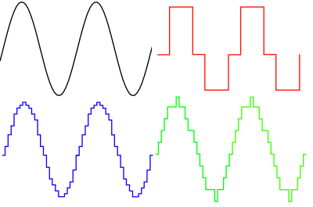
Pulse Code Modulation
Bit rate (2 bits)
Frequency (8 Samples)
Original Wave (Continuous)
Bit rate (6 bits)
Frequency (64 Samples)
Bit rate (4 bits)
Frequency (48 Samples)

Slide 4
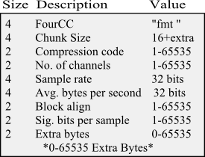
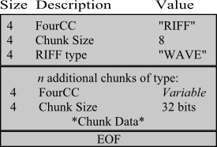

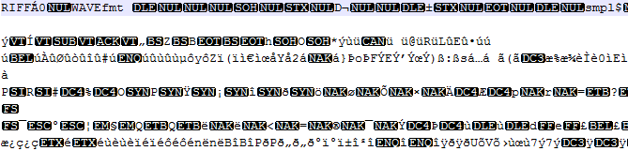
WAV Files

Slide 5
OpenAL
Created By Loki Games for game porting
  Now 'looked after' by Creative Labs (Soundblaster!)
Modelled on OpenGL
  State machine based
Calculates Sounds in 3D space
Automatically pans across 7.1 speakers
Can add reverb, pitch, doppler, etc

Slide 6
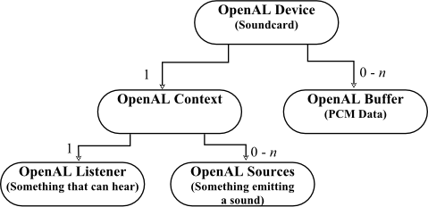
OpenAL Structures
We only have a limited number of these!!!

Slide 7
Simple OpenAL Setup
ALuint source;
ALuint buffer;
char* somePCMdata = LoadAWAVFile();
ALuint size = GetWavDataSize(somePCMdata);
ALuint freq = GetWavDataFrequency(somePCMdata);
alGenBuffers(1,&buffer);
alGenSources(1,&source);
alBufferData(buffer,AL_FORMAT_STEREO16,somePCMdata,size,freq);
alSourcei(source,AL_BUFFER,buffer);
alSourcePlay(source);

Slide 8
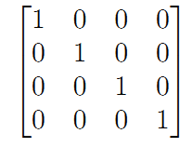
Simple OpenAL Setup
Vector3 dirup[2];
//forward
dirup[0].x = -listenerTransform.values[2];
dirup[0].y = -listenerTransform.values[6];
dirup[0].z = -listenerTransform.values[10];
//Up
dirup[1].x = listenerTransform.values[1];
dirup[1].y = listenerTransform.values[5];
dirup[1].z = listenerTransform.values[9];
alListenerfv(AL_ORIENTATION,(float*)&dirup);
alListenerf(AL_GAIN,s_volume->GetFloat());
alListenerfv(AL_POSITION,(float*)listenerTransform->GetWorldPosition());
Translations
X
Y
Z
W
Rotations

Slide 9
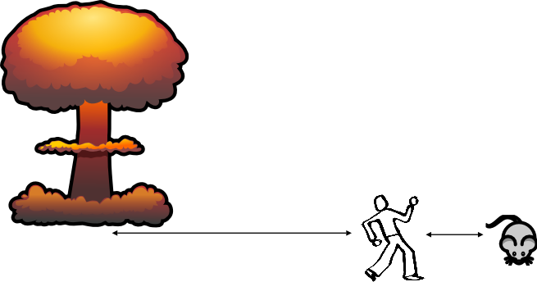
OpenAL Sources
We can have an endless number of objects emitting sound in our games, but we only
have a limited number of OpenAL sources to give to our emitters each frame...
Massive nuclear explosion
(Loud!)
Mouse (Quiet)
Listener node

Slide 10
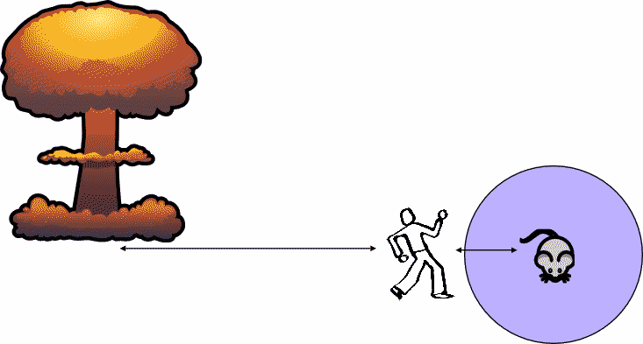
OpenAL Sources
Large Radius
Limited Radius

Slide 11
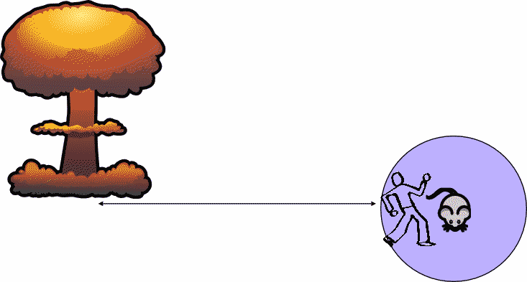
OpenAL Sources
We still hear the mouse, not the explosion!

Slide 12
OpenAL Sources
PRIORITY_HIGH
PRIORITY_LOW
Using priorities, we can ensure the correct sounds are given sources

Slide 13
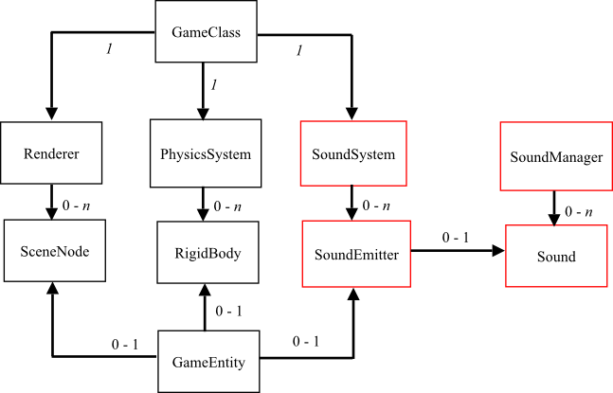
SoundSystem Integration

